Slide 2
Notes to the Presenter
Slides 4-10 contain notes for the presenter and are hidden.
You may include your picture and company logo on one slide only
It is appropriate to provide a brief background (1 minute or less) on your organization.

Slide 3
Presentation Best Practices
Frame your presentation by answering:
What do you want your audience to learn?
What do you want your audience to do differently?
What result or outcomes do you want your audience to realize?
Clarify your session objectives at the beginning of your presentation.

Slide 4
Presentation Best Practices
A picture is worth a thousands word. A good goals is to aim for 7 words per slide.
Increase attention and interaction by using a variety of communication mediums, such as polls and videos.
Inform PowerBIUG team of plans if using videos, audio, etc. to ensure appropriate AV & room arrangements are made
Plan and follow a rough agenda including a breakdown by minute to help stay on track.

Slide 5
Example of Text Layout
Main topic 1: size 28pt
Size 24pt for the subtopics
Size 24pt for the subtopics
Main topic 2: size 28pt
Size 24pt for the subtopics
Size 24pt for the subtopics
Main topic 3: size 28pt
Size 24pt for the subtopics
Size 24pt for the subtopics

Slide 6
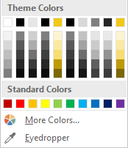
Slide Palette Info
The PowerPoint palette for this template has been built for you and is shown below. Avoid using too many colors in your presentation.
Select the 4th color from the left for subheads and 1st level non-bulleted text color, or wherever “color” text is preferred over the default black/white text
Accent colors 1-6 – (6 Theme Colors to the far right)
Text
Dark 2
Accent 1
Accent 2
Accent 3
Accent 4
Accent 5
Accent 6
Use Accent 1 as the main accent color. Use Accent 2 and Accent 3 when additional colors are needed.
Use Accents 4-6 sparingly – only when more colors are necessary.

Slide 7
Chart Example

Slide 8
Lots of data? Minimalize
Gray is used to de-emphasize data that is less important. Use cool gray 3 or cool gray 7. See slide 7 for color formulas.
All elements have the same interior margins as text blocks.
When a chart or graphic, has more elements than can easily be aligned to the grid, align the outer edges of the group, top, bottom, left and right edges to the grid.
It is preferable to keep the group aligned to the left border.
130M
140M
125M
Other
Other
Other
Other
Other
Other

Slide 9
Chart Example

Slide 10
Notes (hidden)
Some speakers at Microsoft like to use this slide for hidden “notes slides”.
Delete it if you don’t want to use it.
Next: <next slide title>

Slide 11
Spatial Data Analysis in Power BI
Tony McGovern

Slide 12
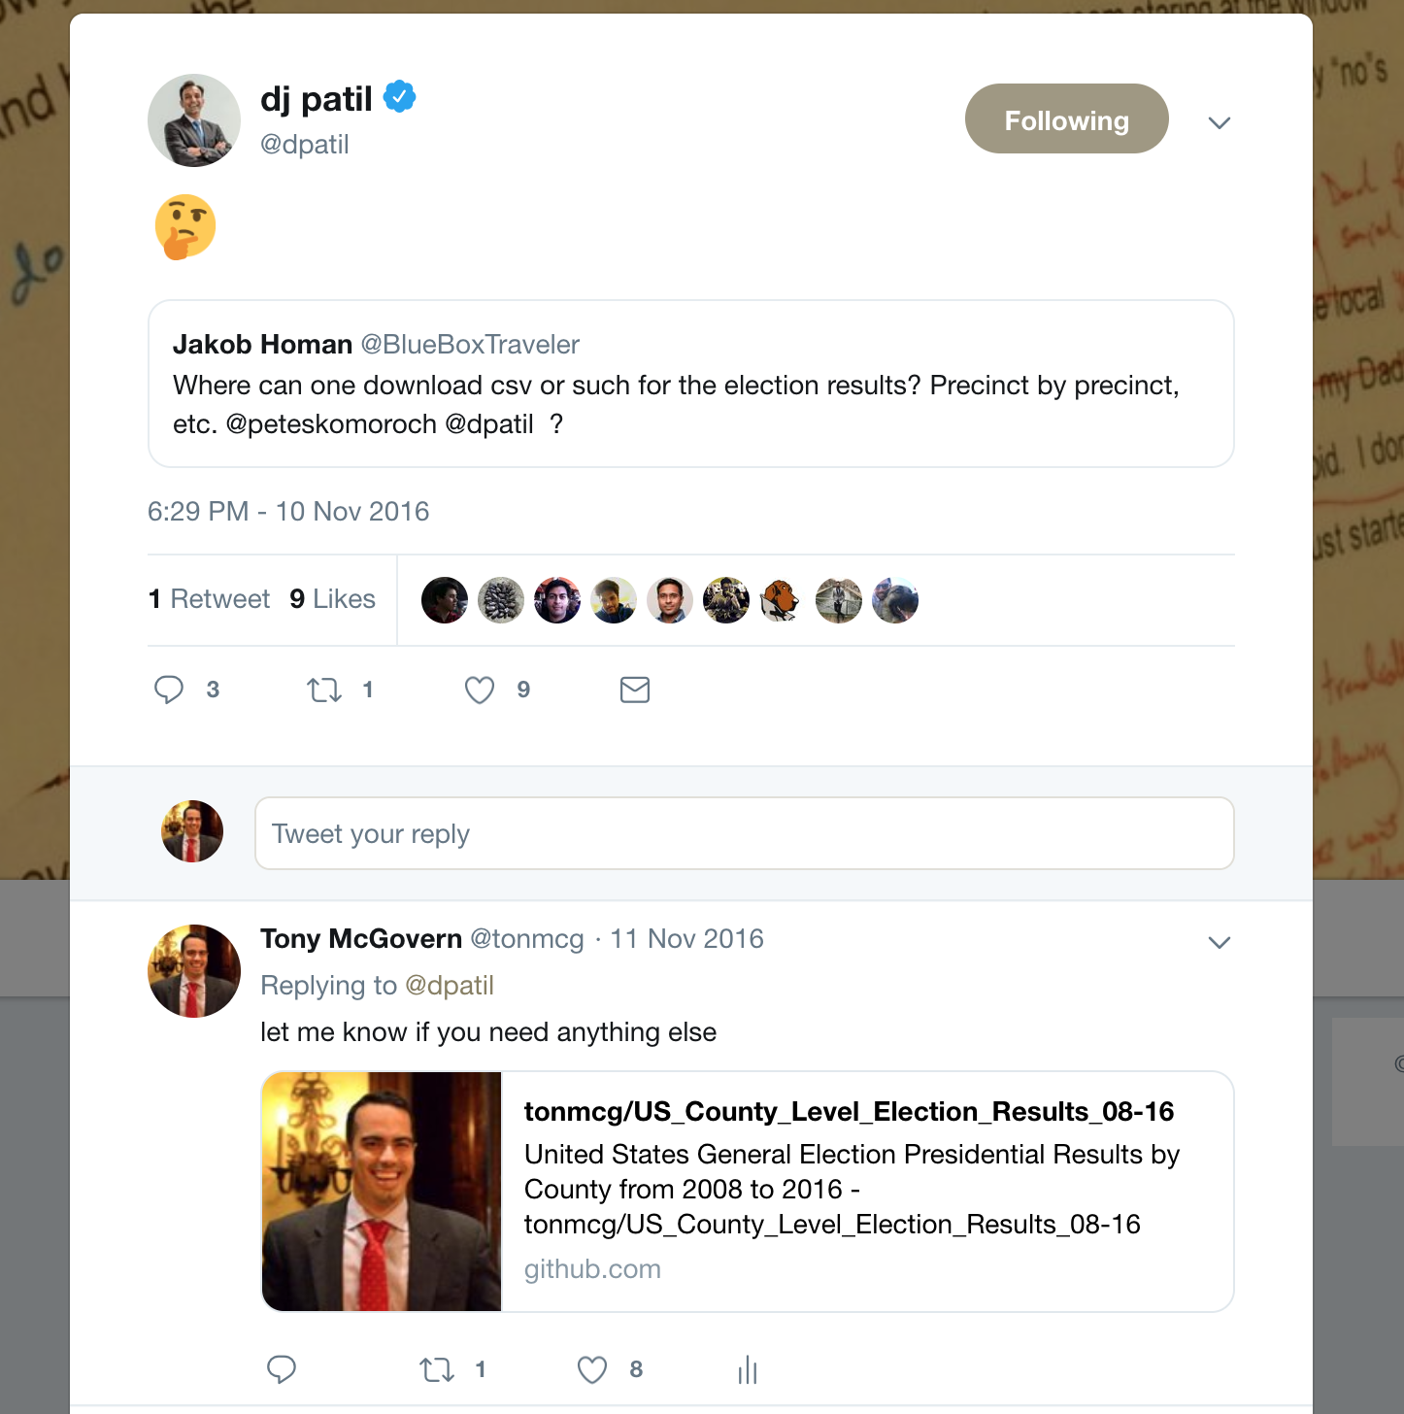
It All Started with a Tweet …
Notes:
On Saturday morning, November 12th 2016, four days after the results of the U.S. presidential election, I read this on Twitter.
Surely this has to be an easy Bing search. Is it true that lower-level U.S. presidential election results are no where to be found? I see them everywhere: NYTimes, Washington Post, CNN, BBC, etc.
After putzing around for 20 or so minutes, I found out that yes, that data is available, but it's not open data. It's not available for me and you.
So, with the blessing of my wife and kids, I set out that day to change that.

Slide 13
Open Source Election Results
Notes:
WHAT'S THE STORY?
With Python in hand, I scraped some websites and got U.S. presidential election results for all 3,142 counties. And once I was done, I also scraped 2008 and 2010 county-level U.S. presidential election results. And I put these results on GitHub, free for anyone with an internet connection to use.
WHAT PROBLEM DOES THIS SOLVE?
Before I started this GitHub repo, you just couldn't find county-level results for the 2008, 2012, and 2016 U.S. presidential elections. It was hard to get data. Now, it's open sourced.
WHY IS THIS IMPORTANT?
U.S. presidential elections have important consequences for much of the world.
I truly believe, open data is integral for a more informed citizenry, for better policy outcomes, and for more accountable and robust democratic institutions.
TAKEAWAY:
Data availability shouldn't be reserved for those who have enormous amounts of time, skill, and resources.
With Power BI, you have the "power" to make data and analytics more freely available to anyone with an internet connection.

Slide 14
Beautiful Thematic Maps (Not in Power BI)
Notes:
WHAT'S THE STORY?
So I set about trying to explain the results of the election through visuals and analysis. And what did I learn? Not only was county-level U.S. 2016 election data nowhere to be found, simple maps that showed these results, or these results with other data were non existent. So I created those as well.
Subscribers to the NYTimes or the Washington Post shouldn't be the only ones who have access to county-level election data or maps.
After 120+ hours scraping websites with Python, creating interactive maps with JavaScript, and performing analysis in R, I realized a few important lessons:
- it's hard to update this data
- it's even harder to update the map
- it's super duper hard to perform advanced analytics and share it with the world.
WHY IS THIS IMPORTANT?
Power BI offers us a better way. With Power BI, you can get and update the data more more easily, update the maps with great third party visuals, and perform advanced analytics that you can share with the world.
TAKEAWAY:
We have the power to make data and advanced analytics more open, more robust, and more widely available

Slide 15
Session Agenda
Explore how Mapbox and Esri help your create beautiful thematic maps
Understand what out of the box tools are available in each service
Notes:
Create beautiful thematic maps in Power BI
Understand what out of the box tools are available to enhance analysis

Slide 16

Tony McGovern
Hacker. Artist. Storyteller. Data lover.
Data Scientist
emdata.ai
http://github.com/tonmcg/
@tonmcg
Notes:
Data Scientist at emdata
We love Power BI helps us easily build impactful data applications that we allow us to scale at a fraction of the time, energy, and cost
And we love working with organizations that are making a difference in the world -- for us Power BI is the way for everyone to do more, better

Slide 17
Three Lessons for Spatial Analytics in Power BI
Lesson No. 1: Use Mapbox or Esri ArcGIS!
Lesson No. 2: Get Good Data!
Lesson No. 3: Use Out-of-the-box Analytics!
Notes:
Remember those hard-won lessons I mentioned previously?
I want to share with you three lessons that will help you make beautiful maps and perform impactful analysis quickly and robustly
A quick poll:
- who here has created a map in Power BI?
-for those of you who have created maps in Power BI before, did you created these for someone else, either for colleagues or for the public?
- if you created these for your colleague or boss, have they themselves ever created a map?

Slide 18
Esri ArcGIS makes the (spatial) world go round

Slide 19
Mapbox makes the (spatial) world more open
Notes:
WHAT'S THE STORY?
WHY IS IT IMPORTANT?
WHAT'S THE TAKEAWAY?

Slide 20
What We’re Going to Build Today: Esri ArcGIS Visual

Slide 21
What We’re Going to Build Today: Mapbox Visual

Slide 22
Bonus Visual: A Map of Every Building in America
Notes:
And as a bonus, we'll walk through how to download a layer of every building in Washington State and use it within a Mapbox Visual. Neat, huh?
Now before we get to it, a quick poll:
- who here has used either the Esri ArcGIS Visual or the Mapbox Visual?

Slide 23
Lesson No. 1: Use Mapbox or Esri ArcGIS!

Slide 24
Using Esri ArcGIS Boundaries

Slide 25
Using Mapbox Layers

Slide 26
Lesson No. 2: Get Good Data!

Slide 27
Getting Spatial Data from Socrata Open Data Network

Slide 28
Getting Spatial Data from U.S. Census Bureau API

Slide 29
Cleaning Your Spatial Data with SmartyStreets

Slide 30
Lesson No. 3: Use out-of-the-box analytics!

Slide 31
Coordinates Data: Heat maps

Slide 32
Boundary Data: Extrusions

Slide 33
What Did We Learn?

Slide 34
Three Lessons for Spatial Analytics in Power BI
Lesson No. 1: Use Mapbox or Esri ArcGIS!
Lesson No. 2: Get Good Data!
Lesson No. 3: Use out-of-the-box analytics!
Notes:
Today we learned:
- how to add layers to a custom Mapbox visual with Mapbox Studio
- how to use Esri ArcGIS boundaries with boundary data

Slide 35
Three Lessons for Spatial Analytics in Power BI
Lesson No. 1: Use Mapbox or Esri ArcGIS!
Lesson No. 2: Get Good Data!
Lesson No. 3: Use out-of-the-box analytics!
Notes:
We also learned where to get good location data and how to clean our messy spatial data:
- We saw where to get good data usig Socrata and Census APIs
- We saw the potential SmartyStreets has for our Power BI applications

Slide 36
Three Lessons for Spatial Analytics in Power BI
Lesson No. 1: Use Mapbox or Esri ArcGIS!
Lesson No. 2: Get Good Data!
Lesson No. 3: Use out-of-the-box analytics!
Notes:
We also saw how easy it is to create:
- heatmaps
- extrusions

Slide 37
Bonus Lesson: Use Twitter!

Slide 38
Use Twitter!
Notes:
Remember that tweet that started this talk? The one where DJ Patil asks where we can find 2016 election data?
Well I responded a day later.
I'm absolutely convinced that if I had started this project with Power BI, I would have responded that same day with not only the data, but a full Power BI application ready to share

Slide 39

Seriously, Use Twitter!
Notes:
I met Graham on Thursday at a Power BI User Group meeting in Washington, D.C. He's new to mapmaking and wanted to replicate one of the demos I showed at that meeting.
He's brand new to the mapmaking world in Power BI. And he had some issues.
So he got on twitter, reached out to me about where to get some data and layers and within an hour, he produced this.
What's really amazing is that he followed those three rules to the tee:
- He used Mapbox
- He got good data
- He used out-of-the-box features to perform analysis
- and he also used the bonus lesson: he used Twitter!

Slide 40
Resources
Open Source Election Results https://github.com/tonmcg/US_County_Level_Election_Results_08-16
United States Census API https://api.census.gov/data.html
Socrata Open Data API https://dev.socrata.com/
SmartyStreets https://smartystreets.com/
Mapbox Studio https://www.mapbox.com/studio/
A Map of Every Building in America https://github.com/Microsoft/USBuildingFootprints
PowerSocrata https://github.com/tonmcg/powersocrata
PowerCensus https://github.com/tonmcg/powerCensus
Notes:
Create beautiful thematic maps in Power BI
Use those maps for impactful spatial analysis
Understand how to mix in machine learning to your Power BI reports

Slide 41
Questions?

Slide 42
Don’t forget to join your local PUG to enjoy year-round networking and learning.

